Slide 1
MyStudies
Shihab Faruk (VC1C)
sfaruk3131p@gmail.com
Supervisor Razib Ahmed, Razib.ahmed0204@gmail.com

Slide 2
Abstract
MyStudies is a website that helps students prepare for their academics and encourages productivity. MyStudies will allow students to create and review flashcard decks allowing them to curate their studies. The site will also have a bulletin feature that allows students to keep track of important deadlines and tasks. Students will also have the ability to log in and create a personal profile to represent their hobbies and interests. Overall this project will involve creating an intuitive frontend, designing a database to store student information such as decks, bulletin, profile, and creating a backend facilitate.

Slide 3
PLO for Computer Science
Working on this project has helped me learn and hone my programming skills in html, css, and javascript.
I’ve utilized Object oriented programming for my project
I’ve utilized tools such as git, github, Trello to document and track my project progress.
My project requires working on multiple aspects frontend, backend, data

Slide 4
Tools
Javascript
HTML
CSS
Git
Github
MySQL

Slide 5
Use Case #1
Scenario 1: A student will want to review flashcards for a history exam. The student will log in with their proper credentials and in the homepage click the plus button. A modal will pop up and take in definitions and terms inputted from the user in a form. Once submitted a deck object containing the terms will appear on the homepage. The student will click the matching game in the deck container to test themselves.

Slide 6
Use Case #2
A student has to keep track of next week’s Data Structures exam, his sister’s birthday, and a networking event in 3 weeks. The student clicks on the bulletin tab at the top of the homepage. The user then clicks the plus button and through a modal creates a “sticky note”. The user does this for the other 2 events as well. The user can log in to the site and know what reminders they have set for themselves.

Slide 7
Use Case #3
A student has just taken his history final exam and got an 85. He created a deck for review a week before the exam. The student is done for the year and decides he doesn’t need his materials for the class anymore. He logs in with his credentials and at the homepage finds the deck titled History Final. He then presses the x at the top right corner of the deck deleting the flashcard deck for that class.

Slide 8
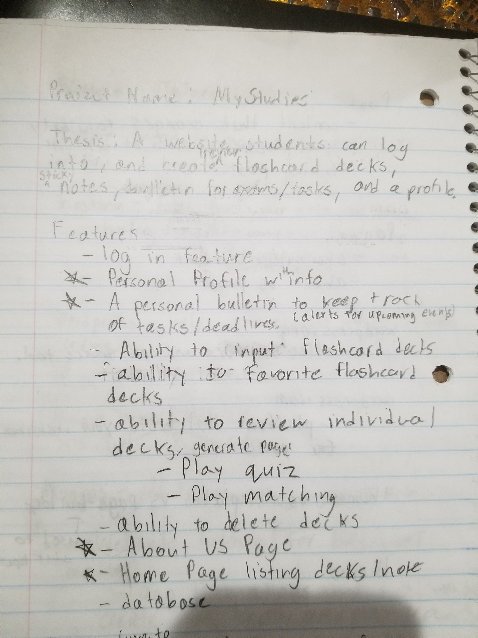
Initial Project Proposal/Brainstorm

Slide 9
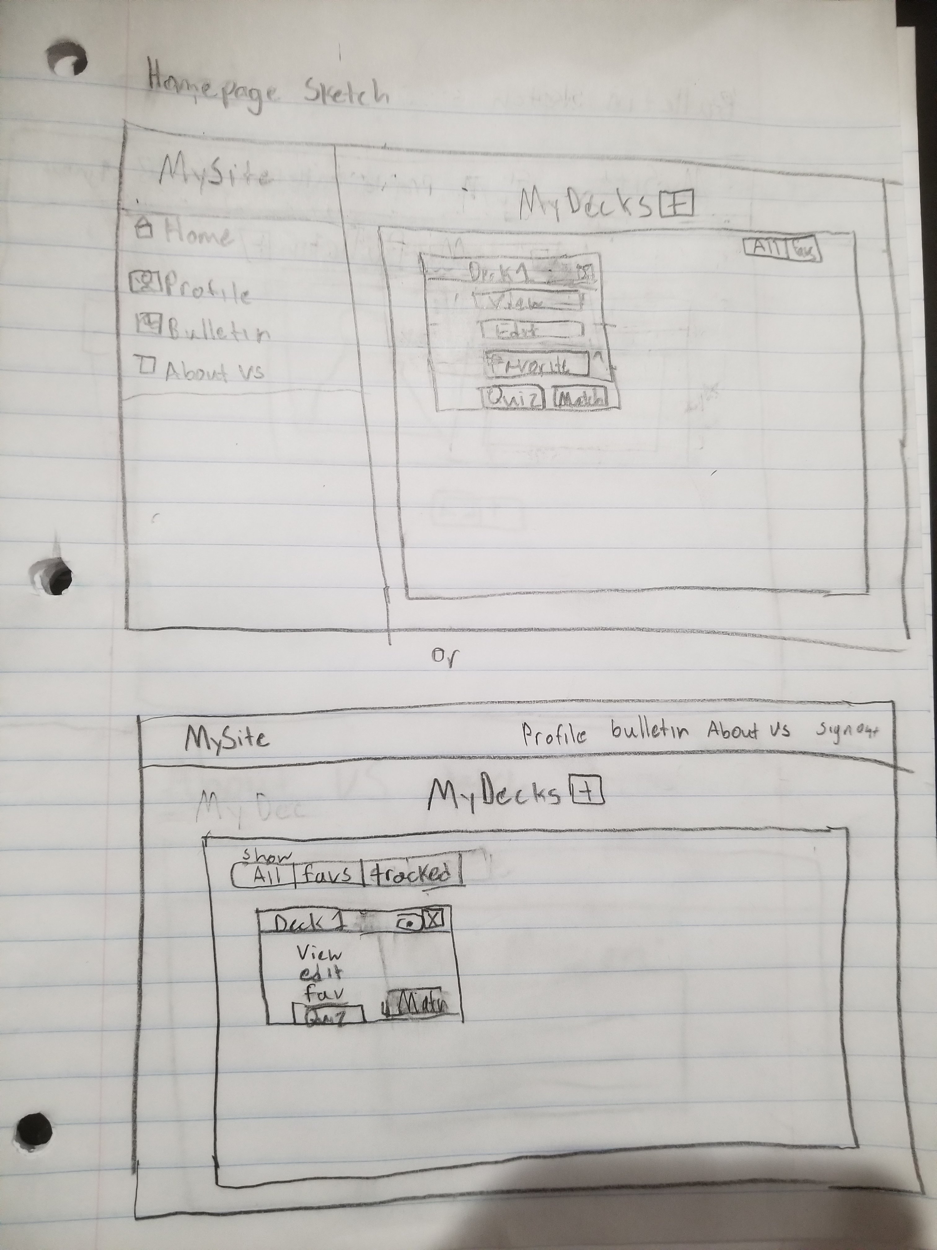
Initial Sketches

Slide 10
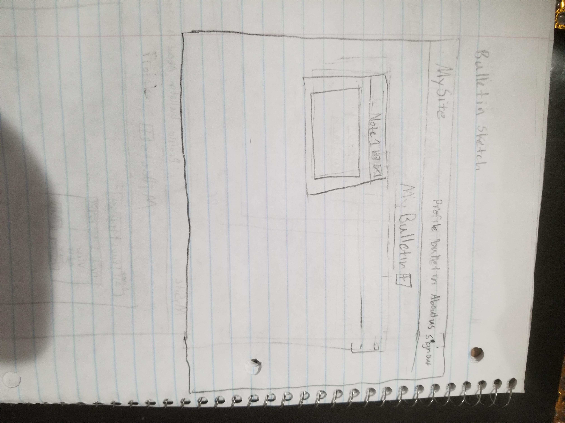
Initial Sketches

Slide 11
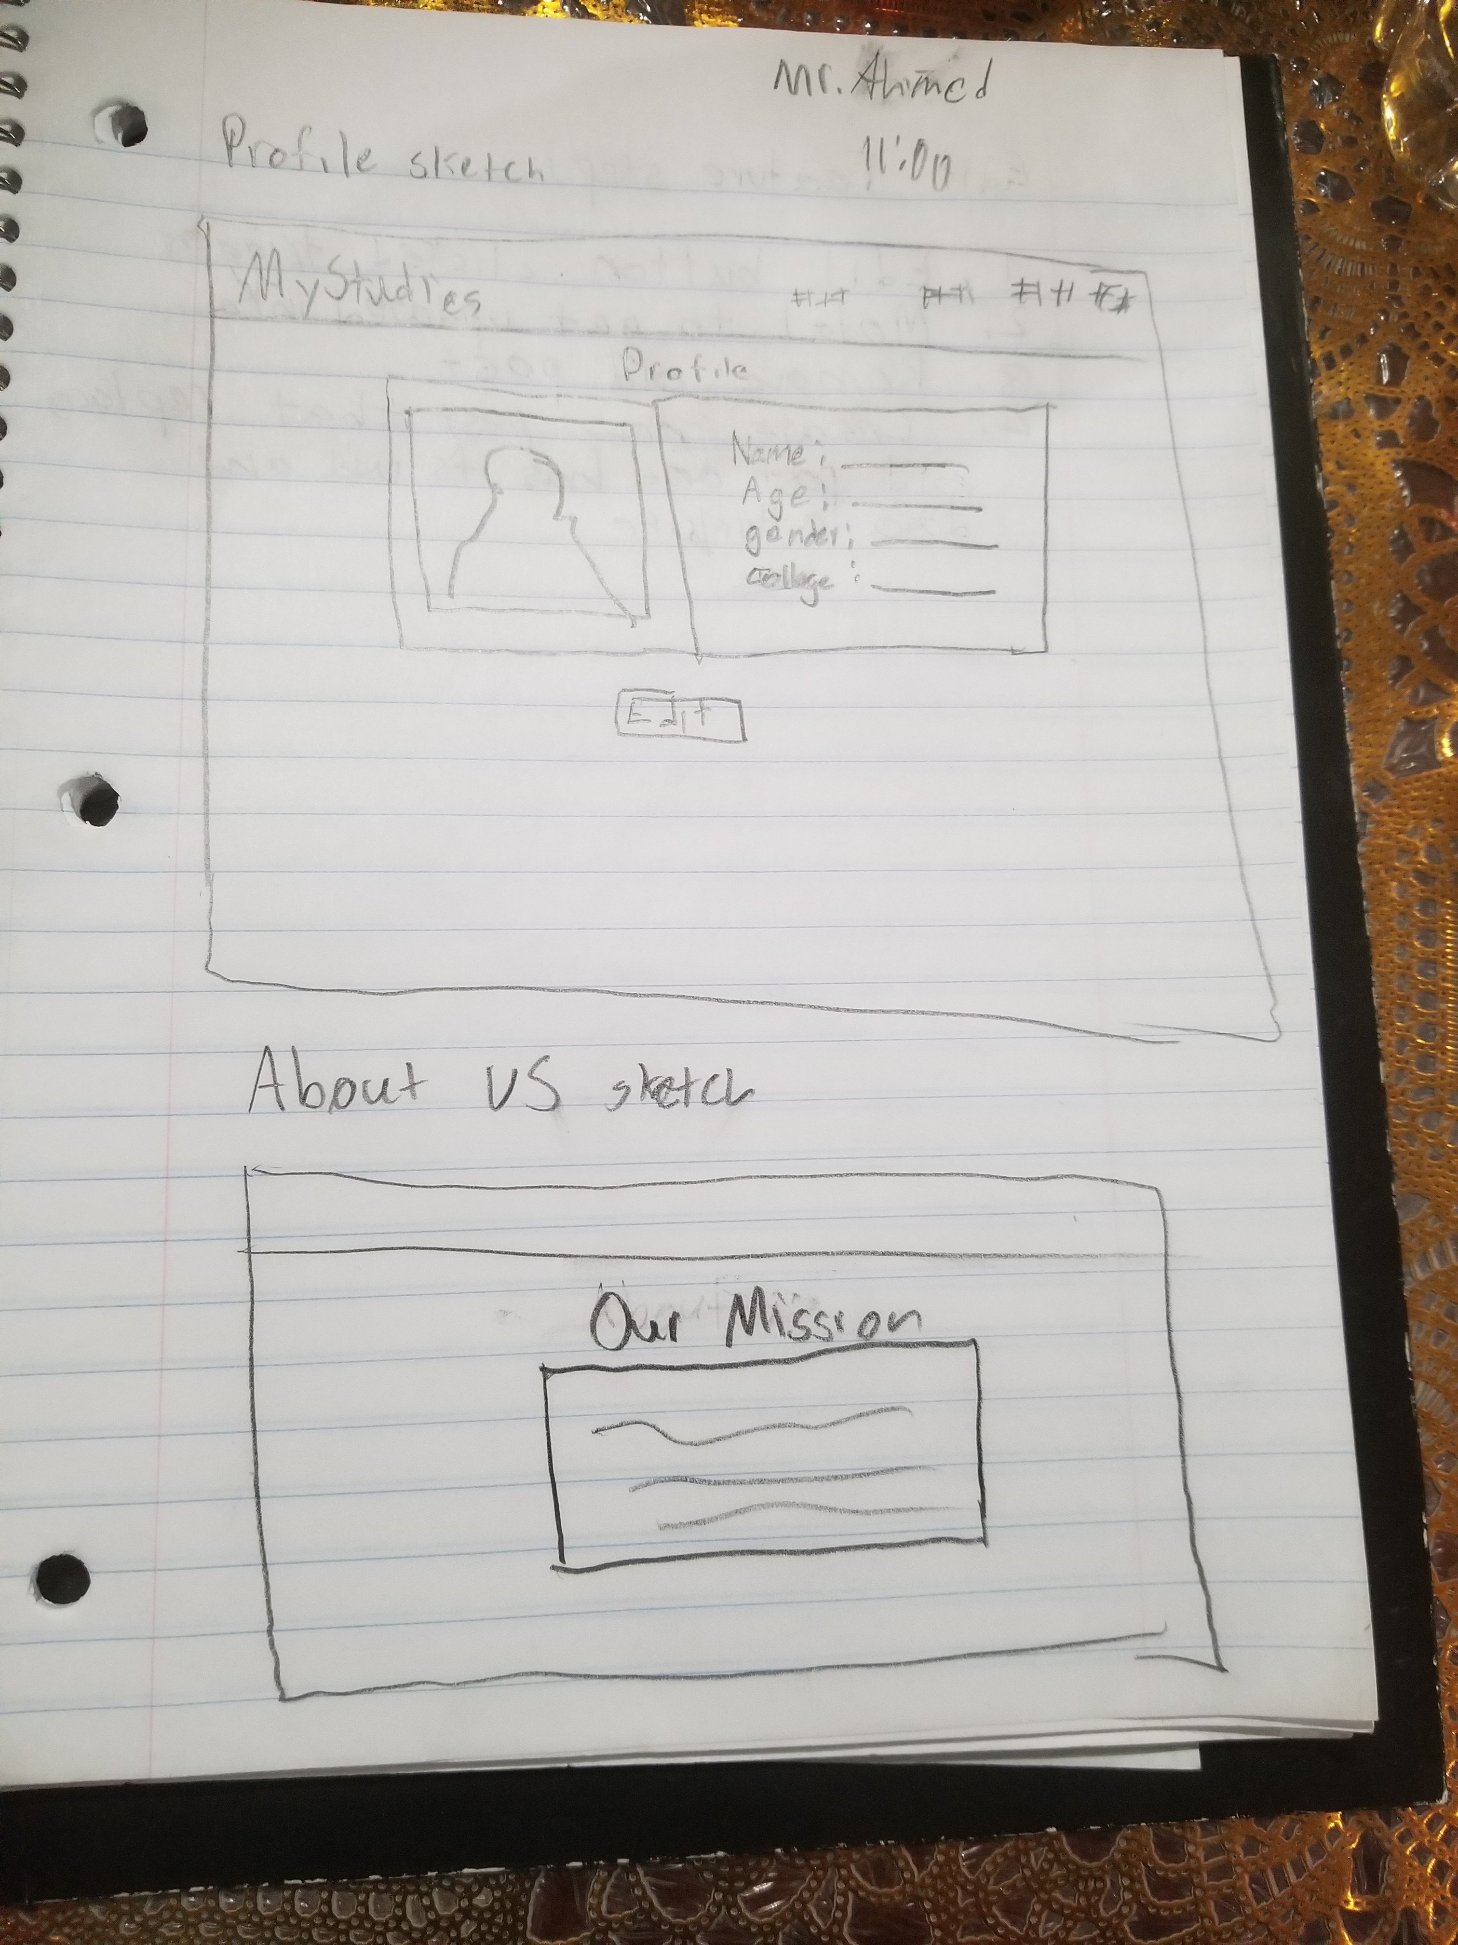
Initial Sketches

Slide 12
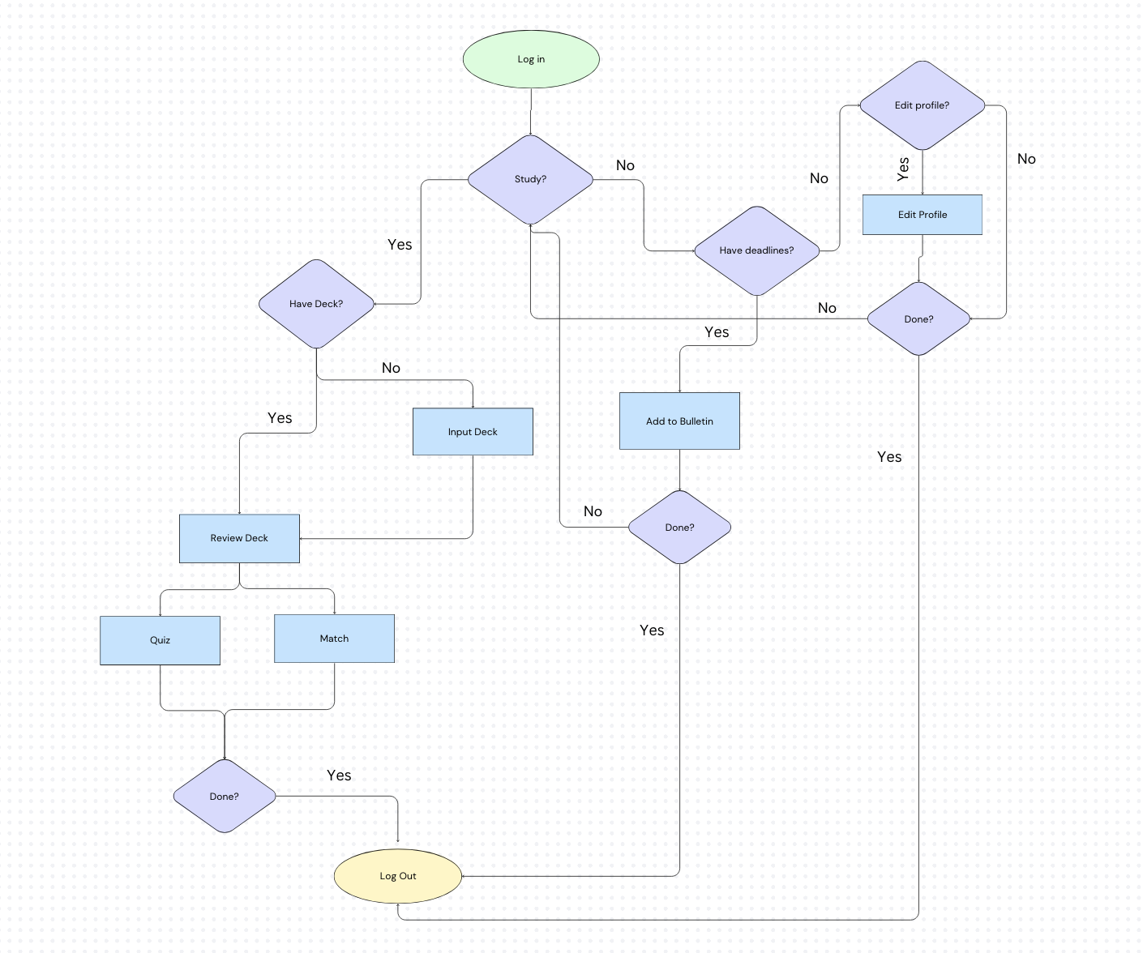
User Flow

Slide 13
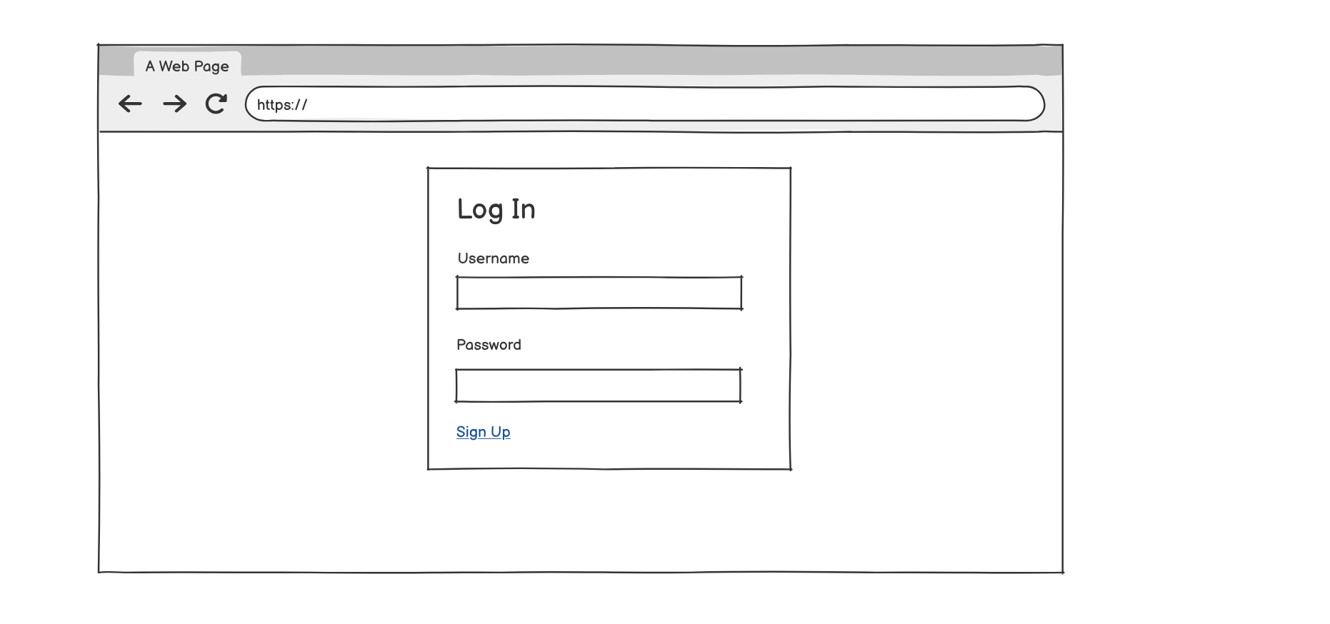
Log In Wireframe

Slide 14
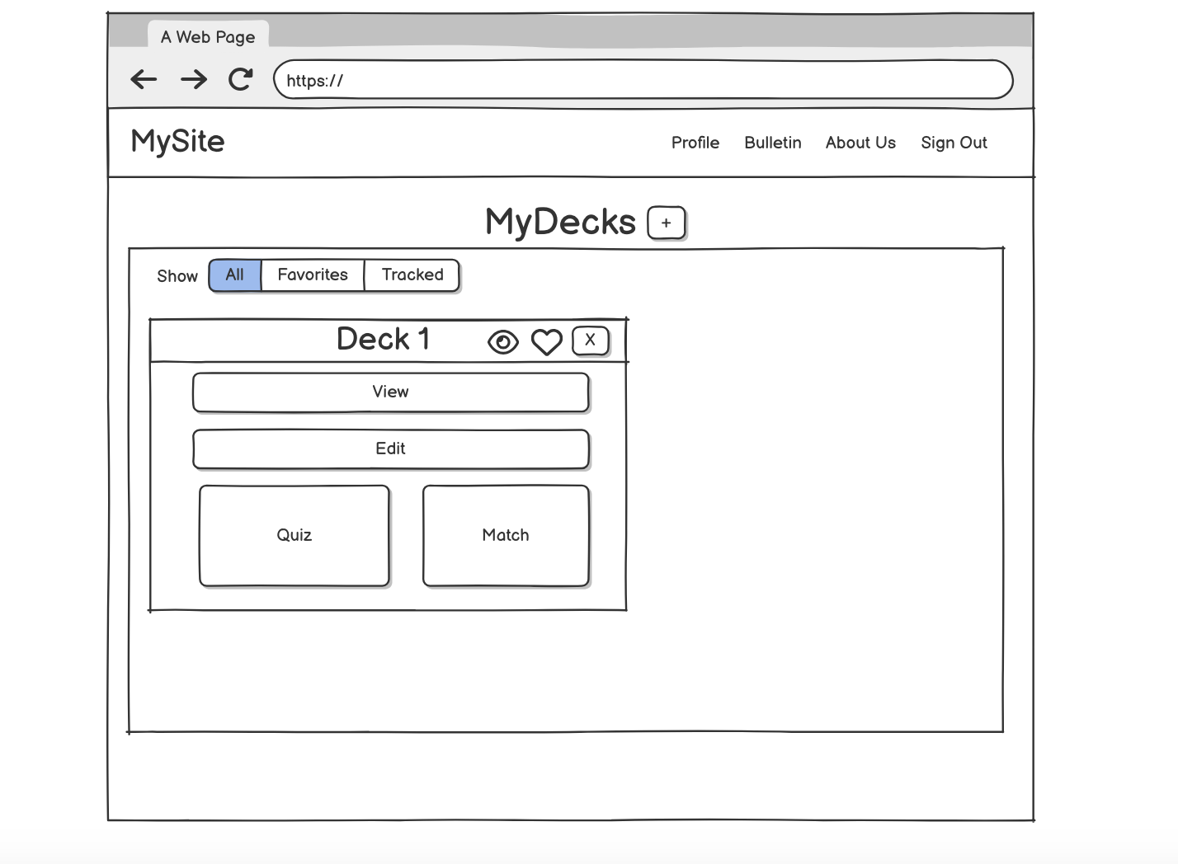
Homepage Wireframe

Slide 15
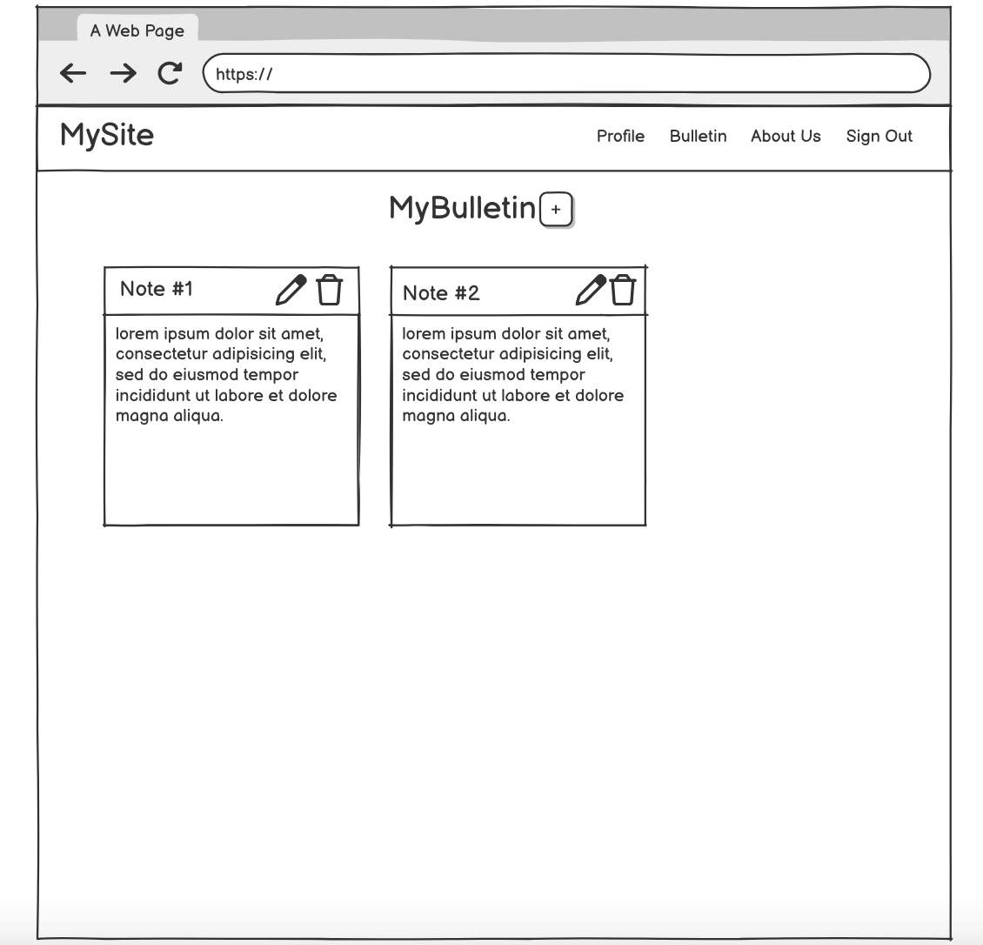
Bulletin Wireframe

Slide 16
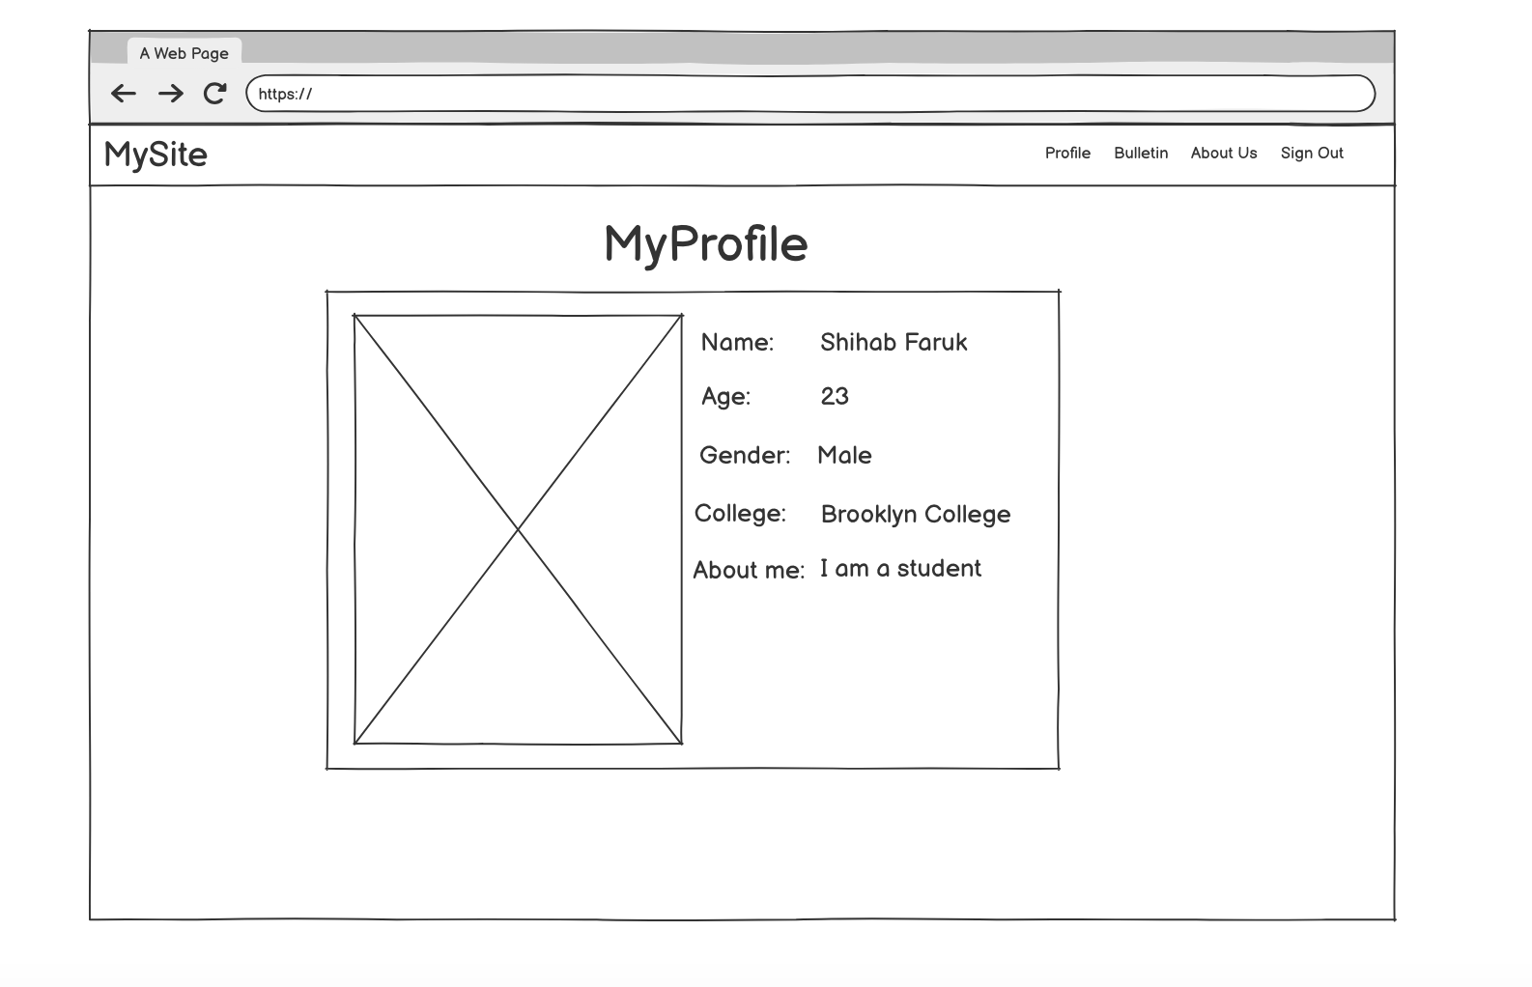
Profile Wireframe

Slide 17
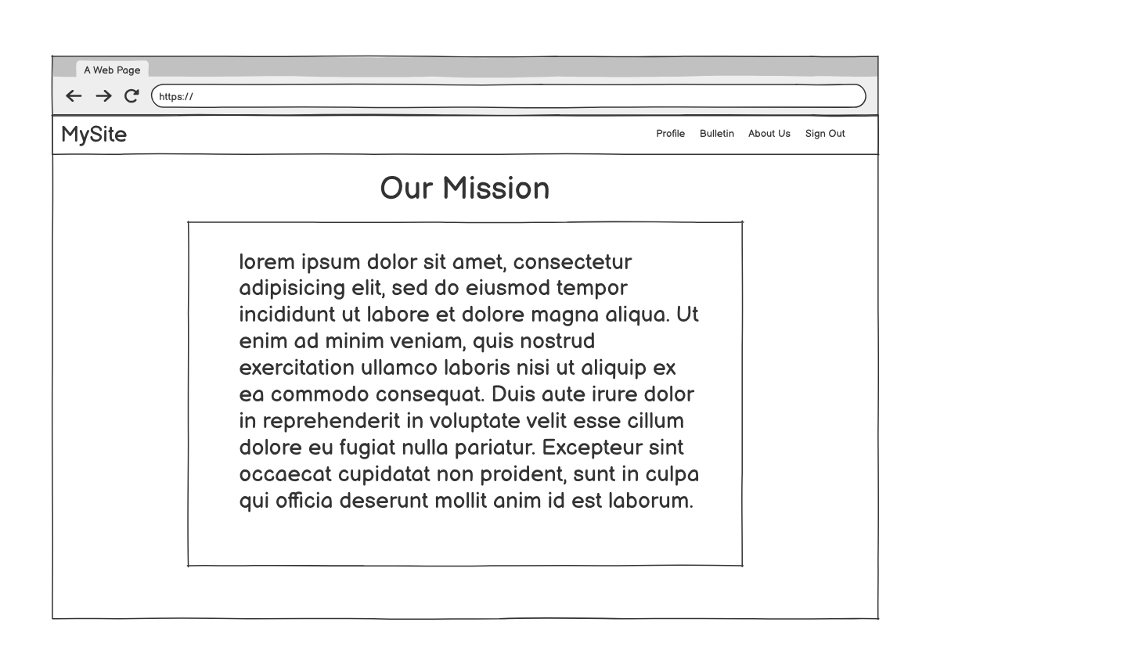
About us Wireframe

Slide 18
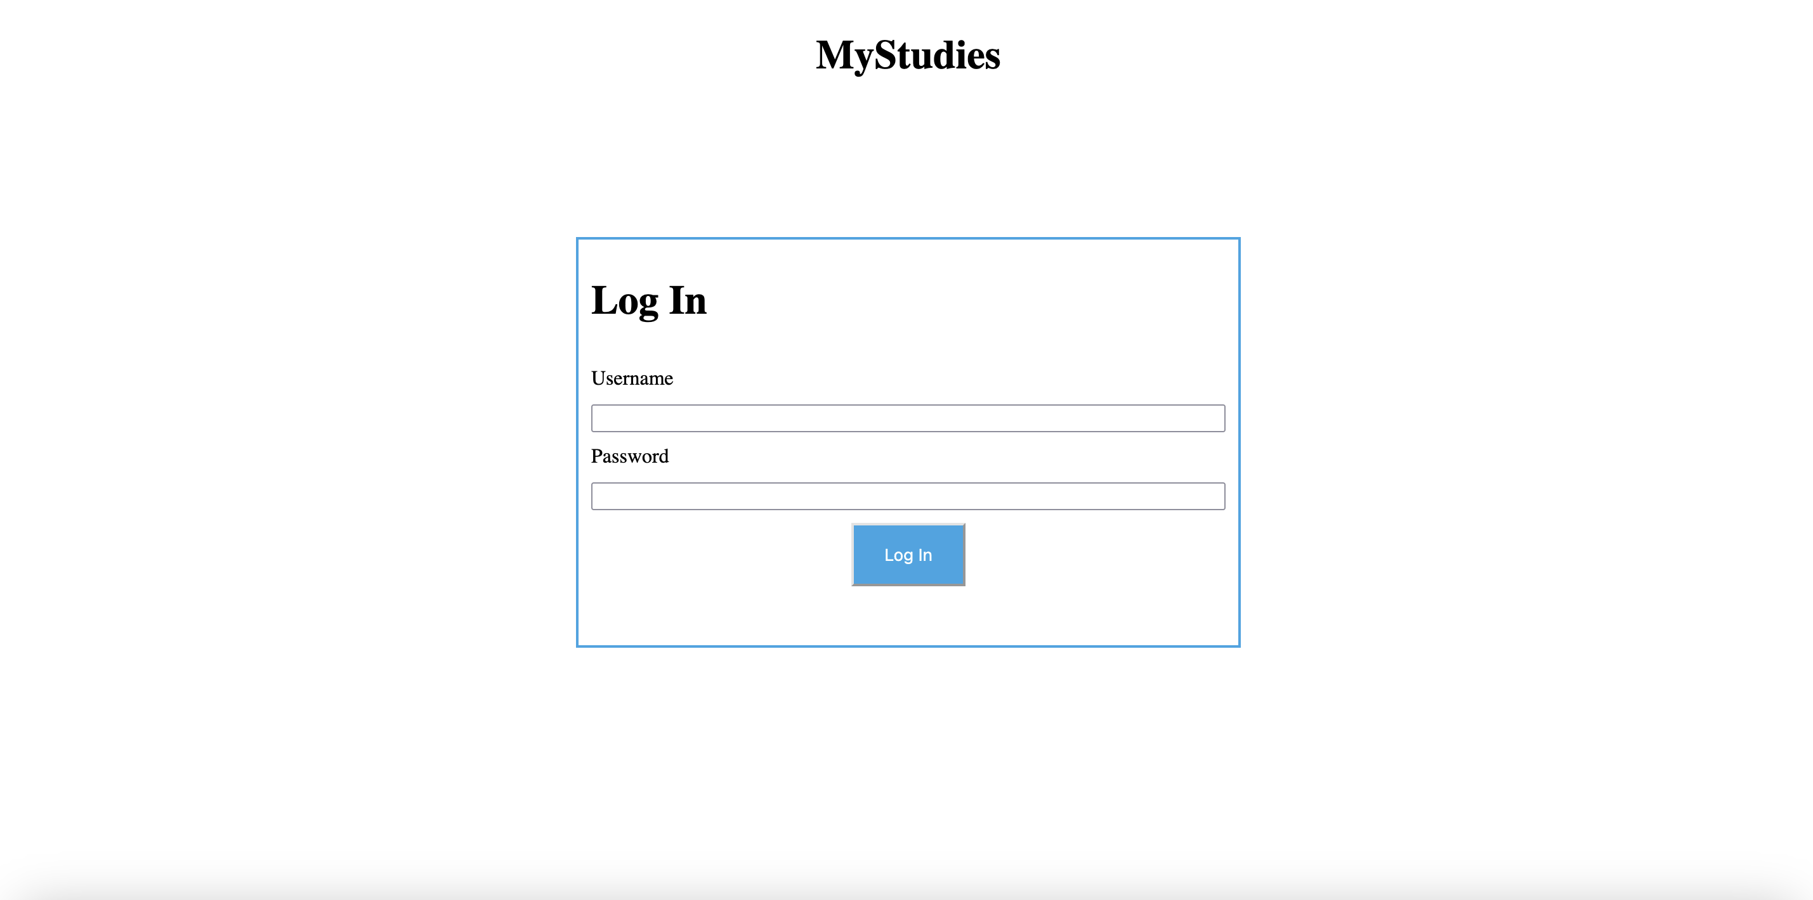
Log In Mockup

Slide 19
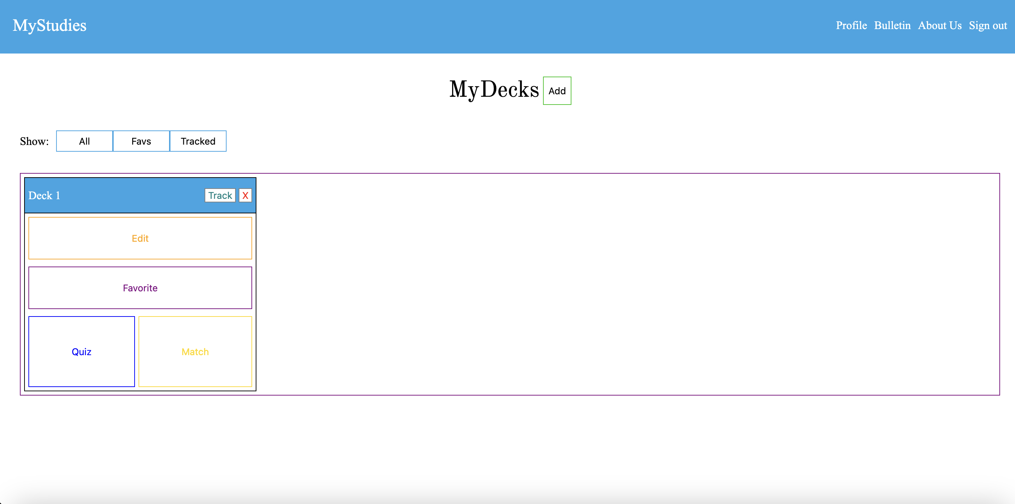
Homepage Mockup

Slide 20
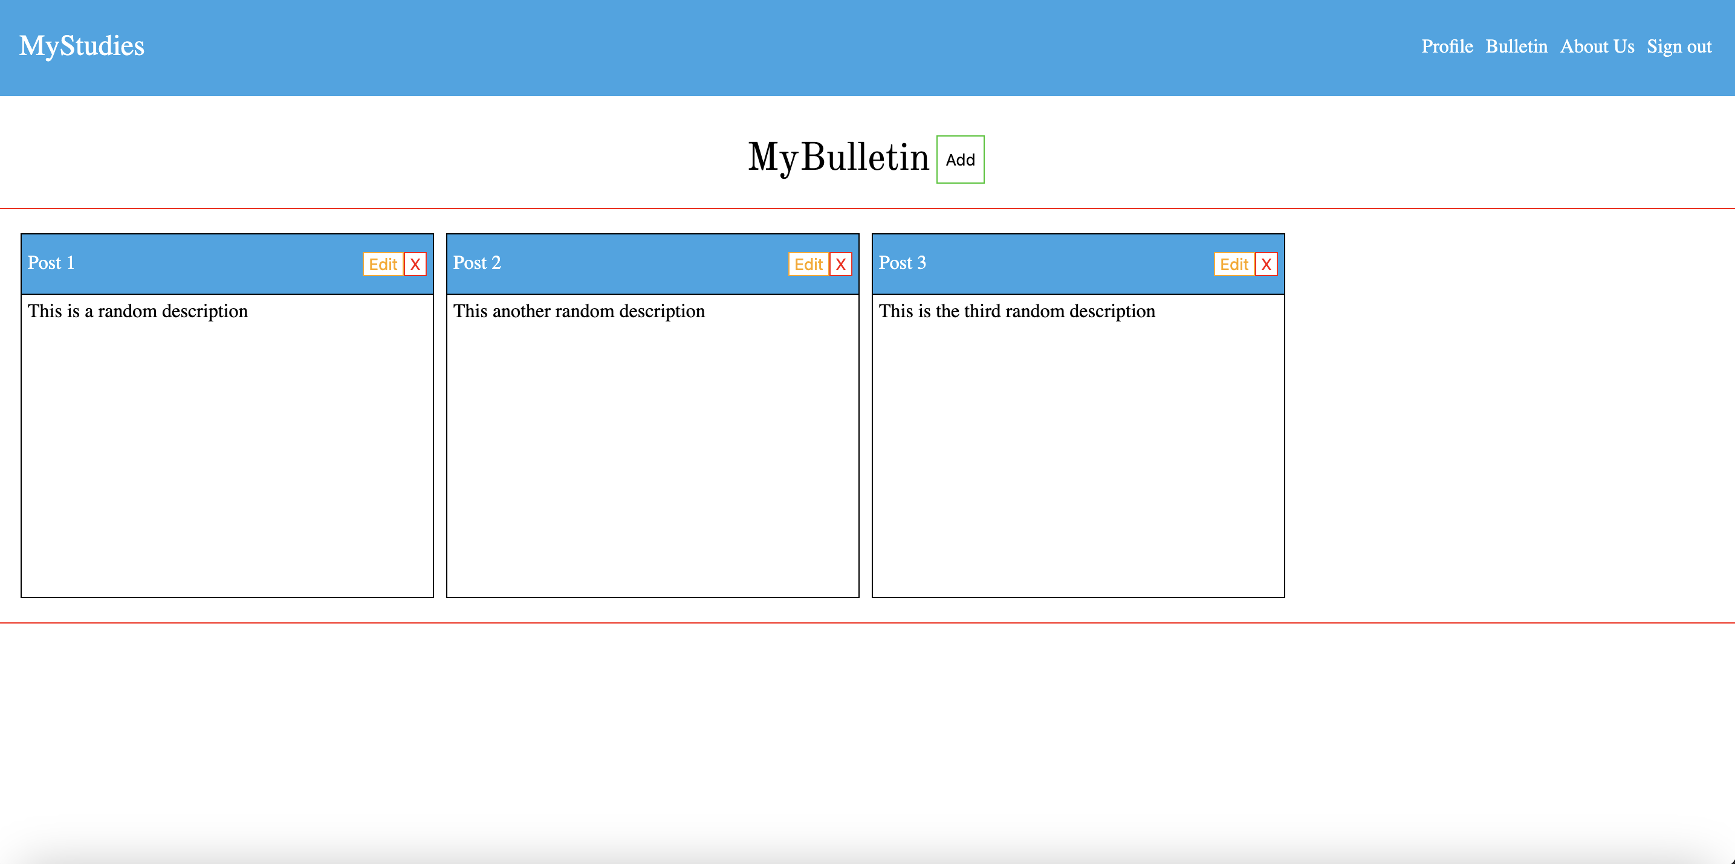
Bulletin Mock up

Slide 21
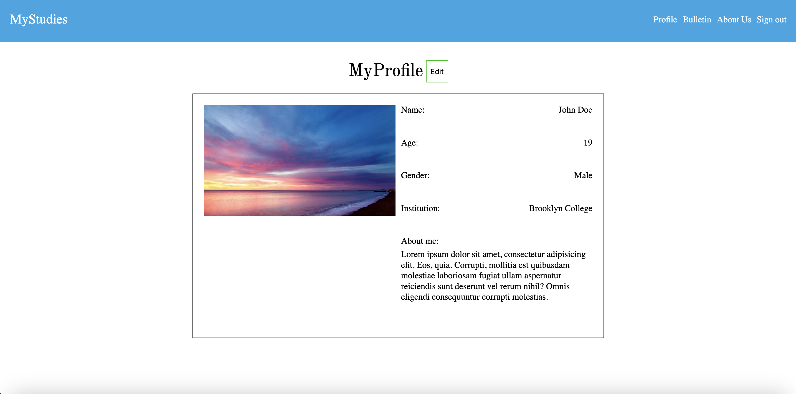
Profile Mockup

Slide 22
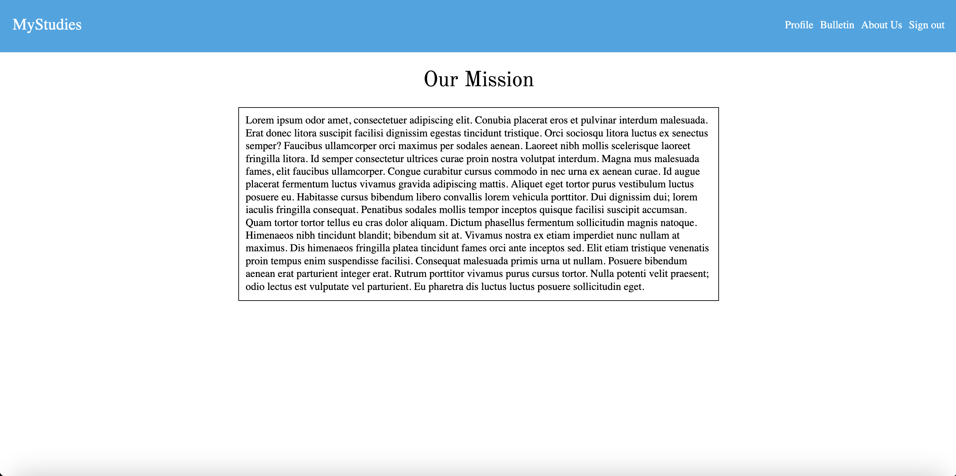
About Us Mockup

Slide 23
Tentative Schedule
Tasks | Timeframe
Planning the project, scope, tools, features | Weeks 1-3. This includes project proposal, project search etc.
Creating the wireframes, working on the UI of the pages. | Weeks 4-5 I will create wireframes on Balsamiq before creating pages in html and css. I will also be researching backend development during this period
Create the demo 1 showing my progress so far | Weeks 6-7
Work on creating the database schema and trying to implement it. | Weeks 7-9
Live Presentation | Week 8
Work on the Backend of the Project. | Week 9-12. This portion of the project I’m more unsure of as I’ve never worked with a backend before.
Demo 2 | Week 11.
Presentation Slides | Week 13-15

Slide 24
Updated Tentative Schedule
Tasks | Timeframe
Live Presentation | Week 8
Bulletin and Profile Functionality | Week 8
Flashdeck Implementation and Features | Week 8-10
NodeJs and Backend Research | Week 8-10
Presentation Slides | Week 10
Demo 2 | Week 11
Backend and Database Implementation | Weeks 11-14
Final Draft Presentation Slides | Weeks 13-15

Slide 25
Features (Completed)
Bulletin Feature allows users to create and delete pinned sticky notes to help remember goals and deadlines.
Flashcard Decks can be inputted and deleted from the main dashboard
Users can update their personal profile to their liking.
About Us Page to give our site an air of professionalism.

Slide 26
Downscoped/Unfinished Features
I’ve decided to forgo implementing the quiz and match mini games due to time constraints and to tighten the scope of the project.
The Flashcard Deck page does not have all of its features particularly filtering, favoriting, and tracking decks.
The backend and database portion of the project was not implemented.
Login not implemented

Slide 27
What I’ve learned
I’ve learned about databases and how database designers use techniques such as normalization to organize data into tables for particular purposes.
I’ve learned how SQL is used to query a database such as MYSQL
I’ve researched how programmers interact with databases using stored procedures and orms.
I’ve learned more about the Dom as a lot of the project requires interacting with the user and that required manipulating the DOM.
I’ve also learned about designing for the user and common pitfalls of design such as only looking at the developers pov and not considering different user scenarios.

Slide 28
What I’ve Learned
I’ve learned and exercised the SOLID principles to write cleaner and more organized code.
I’ve learned about es6 modules and tools such as webpack to bundle and handle code as I write more.
I’ve learned about separating application logic and the User interface to better organize my code.

Slide 29
What would I do differently
I would focus on the main flashcard home page and its features rather than try to focus on extraneous features. The main premise of the project is helping students study their flashcard decks.
I would not use 6 hour tutorials for my research because a lot of unnecessary details cut into potential coding time.
I believe that I could’ve researched when running into a problem instead of learning a topic before I’ve used it for my project.

Slide 30
Research Materials I used
Odin Project used to learn the basics of html, css, JS
FreeCodeCamp SQL Database course
Learn Database Normalization - 1NF, 2NF, 3NF, 4NF, 5NF

Slide 31
Project Repository, Board, Timelog
https://trello.com/b/5IXwlYMt/mystudies
https://github.com/sfaruk2001/MyStudies
https://docs.google.com/spreadsheets/d/1EsyQGhvC0-jWOFdOOozN6SUHjqwqnB2TzA8AkmE8NFk/edit?gid=0#gid=0

